Slide 1
ML4GST Technical Report

Slide 2
Overview
Datasets generated by pygsti simulation python package
1 qubit, XYI model
Simulation setup
Custom X rotational gate, custom Y rotational gate, perfect I gate
X parameters: over rotation angle, depolarizing error
Y parameters: over rotation angle, depolarizing error

Slide 3
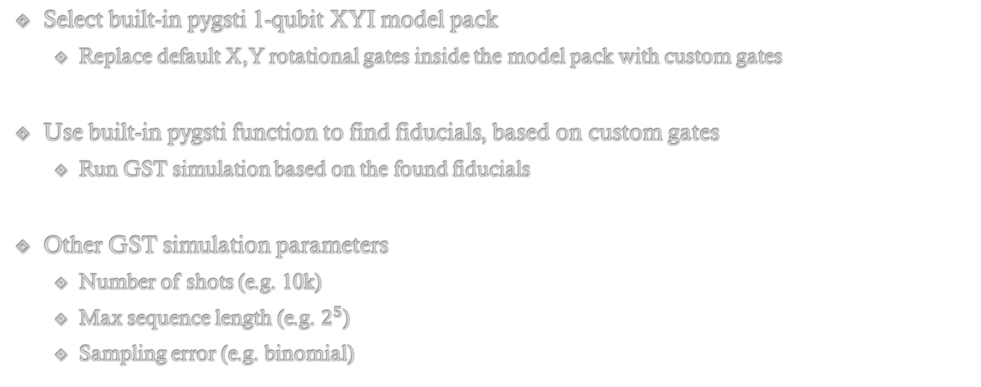
GST Simulation
Select built-in pygsti 1-qubit XYI model pack
Replace default X,Y rotational gates inside the model pack with custom gates
Use built-in pygsti function to find fiducials, based on custom gates
Run GST simulation based on the found fiducials
Other GST simulation parameters
Number of shots (e.g. 10k)
Max sequence length (e.g. $2^{5}$)
Sampling error (e.g. binomial)

Slide 4


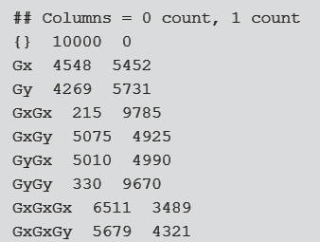
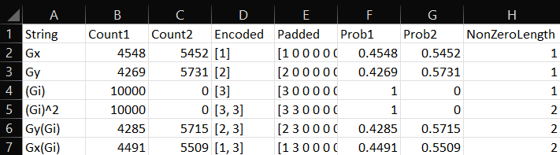
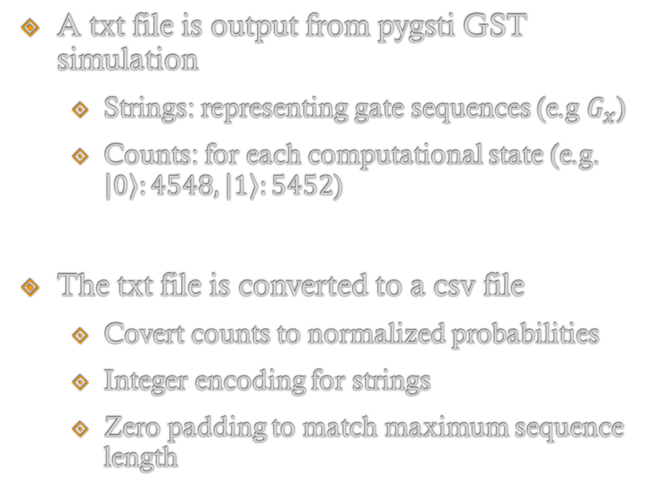
Preprocessing Data
A txt file is output from pygsti GST simulation
Strings: representing gate sequences (e.g $G_{x}$)
Counts: for each computational state (e.g. $\left|0\right\rangle :4548, \left|1\right\rangle :5452$)
The txt file is converted to a csv file
Covert counts to normalized probabilities
Integer encoding for strings
Zero padding to match maximum sequence length

Slide 5
Splitting and Grouping Dataset
Dataset 1: Gate sequences
Integer encoded, zero padded
Dataset 2: Normalized probabilities
Group dataset 1 and dataset 2 by the parameter ‘group size’
If dataset 1 has the shape of (number of gate sequences, padded sequence length)
Return (number of gate sequences/ group size, group size, padded sequence length)
If there is a remainder, fill up the void by repeating data points from the current group
Grouping data increases receptive field, as single gate sequence yields little tomographic info
X
Y
I
X
X
Y

Slide 6
Training Methodology
Curriculum learning (stage training)
Further divide the whole dataset into parts
Starting from shortest gate sequences (first part) to longest gate sequences (final part), in ascending order
Ensure the neural network can learn global features from shorter sequences first, then local fine features from longer sequences later
Neural network can only access one part at each stage (no accumulative parts)
Stage 1: Part1 → Stage 2: Part 2 → Stage 3: Part 3…

Slide 7
Overall Data Pipeline
Inputs
Neural Network
Error Parameters Output
Analytical reconstruction of process matrices (Pauli transfer matrices)
Based on unitary PTM gates with their corresponding rotational angles
Analytically adding depolarizing noise and over-rotation error to create X’, Y’, I’
Computing analytical probabilities
Based on the reconstructed gate set
Calculate the probabilities for all gate sequences
Loss
Training loss: MSE (L2 loss)
PTM Reconstruction
X’
Y’
I’
Run Gate Sequences
Ground-Truth Probabilities
Computed Probabilities
MSE loss

Slide 8
Network Architecture
Encoded Gate Sequences
Probabilities
FC layers & Reshape
Embedding Layer
Embedding Layer/ FC & Reshape Layers
Adding an extra dimension for feature learning
Positional Encoding
Run across the flattened array (group size x sequence length)
Encode positional information across multiple sequences
Cross Attention Layer
Attending aggregated inter and intra sequences relationship between two datasets
Positional Encoding
Positional Encoding
Cross Attention Layer
Transformer
FC Layers
Error Parameters Output

Slide 9
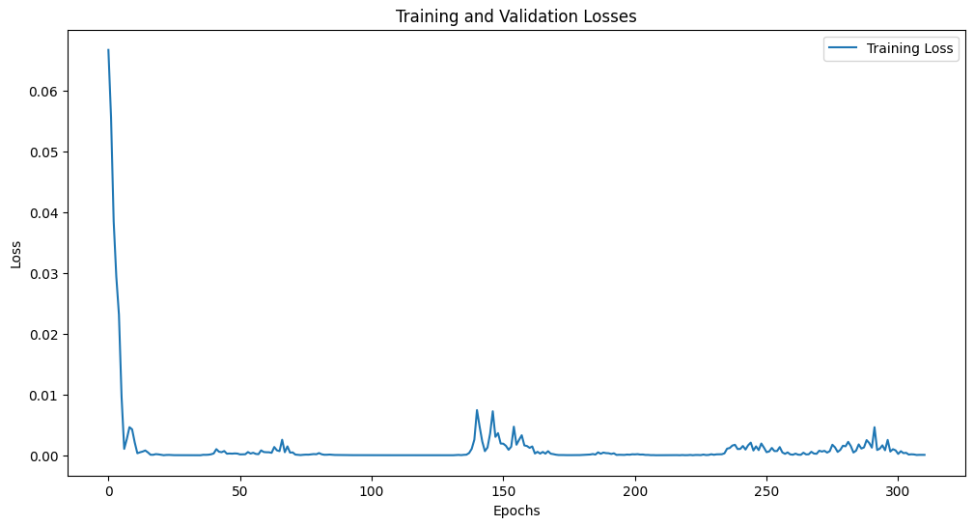
Training Trajectory

Slide 10
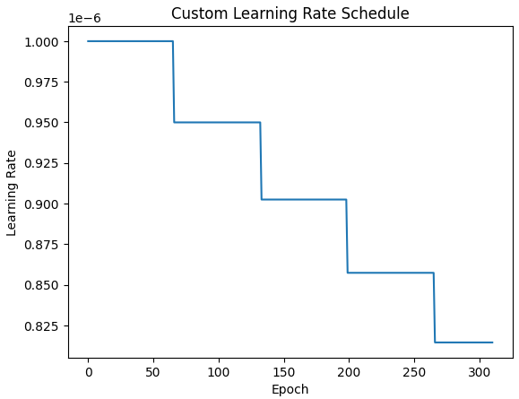
Learning Rate Trajectory

Slide 11
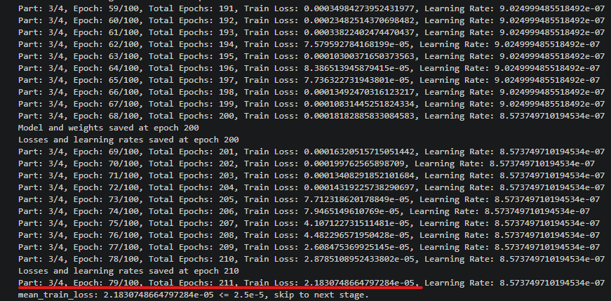
Convergence

Slide 12
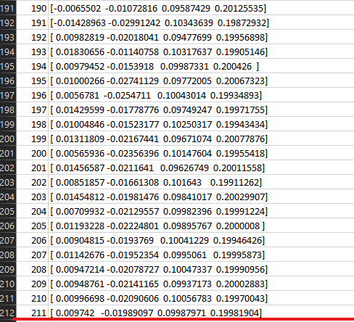
Predicted Values
Ground Truth Values
Depolar X: 0.01
Depolar Y: 0.02
Over Rotation X: 0.1
Over Rotation Y: 0.2
[0.01, 0.02, 0.1, 0.2]

